Slide 1

Design Conceptual Aircraft
via SUAVE
Student Lecturer: Lin Yi
Date：April 29, 2026
Email：linyi@mail.nwpu.edu.cn
Notes:
Hello everyone, I’m Lin Yi. I’m a graduate student supervised by Professor Han and Professor Zhang. I mainly study the overall design and low-boom design of blended-wing-body supersonic transport. Today we’re going to talk about how to do conceptual aircraft design with SUAVE. Ok, before we start today’s lecture. Let’s look at these three aircraft. The first one looks quite ordinary, just like the regular airliners we often see. Does anyone remember which aircraft you took to come to China? Boeing 787? Or Airbus 350? I am from southern China, and I usually fly home on Boeing 737 or Airbus 320. They look very similar to this aircraft, so I can definitely tell that this aircraft is flyable, and I can even guess its lift coefficient maybe around 0.5, this is a widely adopted value. Now let’s look at the third aircraft. It looks so weird, and we can easily tell from common sense that it definitely cannot fly, at least, it is very likely cannot fly. But now let’s look at the third aircraft. Its shape is a bit special, yet it seems capable of flying. But it’s hard to tell whether it can perform well in flight, right? So, to figure out its performance, I need to analyze it quickly, because I don’t want to waste time on an unreasonable configuration, that’s why we need conceptual analysis and design of aircraft. Even for the first aircraft, I can roughly estimate its lift coefficient, but does anyone know its range? We need aircraft conceptual analysis and design as well. SUAVE is a very excellent tool for this.

Slide 2
1、Background Introduction
SUAVE is a conceptual level aircraft design environment built with the ability to analyze and optimize both conventional and unconventional designs. This capability is achieved in part by allowing analysis information for aircraft to be drawn from multiple sources. Many other software tools for aircraft conceptual design rely on fixed empirical correlations and other handbook approximation. SUAVE instead provides a framework that can be used to design aircraft featuring advanced technologies by augmenting relevant correlations with physics-based methods.
Notes:
SUAVE is a conceptual level aircraft design environment built with the ability to analyze and optimize both conventional and unconventional designs. This is the official intro from its website, so I’m not gonna read it word by word, just focus on this line, “SUAVE provides a framework”. To me, I’d rather regard it as a coding style, a style to make code highly encapsulated and fully modular. You can assemble these modules however you want, modify’em, rewrite’em or even create your own with your idea. It’s a super customizable program. And today I hope you can open your laptop and follow my step, install the SUAVE and build a simple case on your own.

Slide 3
2、Prepare
1、Prepare the Anaconda
2、Create python environment
cmd
conda create –n suave python = 3.60
conda activate suave
Libraries | version
matplotlib | 3.3.4
numpy | 1.16.6
scipy | 1.2.3
scikit-learn | 0.18.2
plotly | 5.18.0
3、Install libraries the suave need
cmd
pip install –r requirement.txt
4、Download suave
suavecode/SUAVE: An Aircraft Design Toolbox
suavecode/Tutorials: This is where the tutorial scripts live
Notes:
So the first thing we should do is to create the python environment for SUAVE. I believe you have downloaded the Anaconda before class ok? That will make things more easy. If you haven’t downloaded it yet, the folder I shared with you include the Anaconda installer for Windows 64‑bit version. Then we create a virtual environment with the python version 3.60, Because the SUAVE project has been discontinued for a long time, there are no new releases to be compatible with newer versions of Python. And although you can write Python code in any text editor, it will be more convenient to use a dedicated IDE. The specific IDE won’t affect our class. You can use any IDE you’re familiar with. If you don’t have a preferred editor, I’ve also included the VS Code installer in the shared folder—it’s the code editor I use myself. Once installed it, you just need to install the Python extension from the VS Code extension market, and you’ll be ready to run Python code. Ok back to our topic, I have added my powerpoint into the shared folder, you can open my powerpoint and just copy the command from it. And when we build our simple case you can copy my code from it if you don’t want to type it manually. we have create the python environment, then we should install some libraries suave need, I’ve listed all the required libraries with the correct versions in the requirements.txt. You just need to run this command, and it will automatically install everything you need.

Slide 4
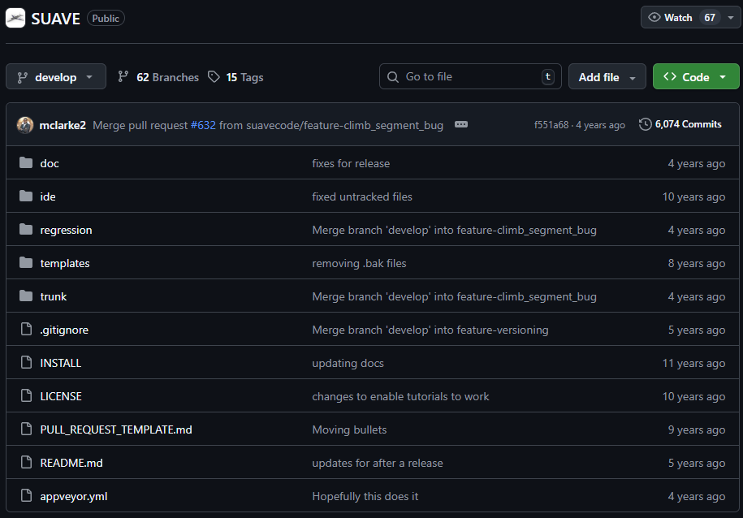
2、Prepare
4、Download suave
suavecode/SUAVE: An Aircraft Design Toolbox
suavecode/Tutorials: This is where the tutorial scripts live
Git bash
git clone https://github.com/suavecode/SUAVE.git
or
Download the zip from release directly
5、Install suave
GitHub repository
cmd
cd D:\SUAVE-2.5.2\trunk ##change the path
python3 setup.py install
Notes:
Once we set up a working environment for SUAVE, we can download the code from the github. I originally wanted you to download everything from GitHub, but GitHub downloads can be a bit unstable due to internet issues. So I’ve put the main SUAVE package and the Tutorial zip file in the shared folder for you. You just need to extract them and open the termination under the main SUAVE directory and run a command to install it.

Slide 5
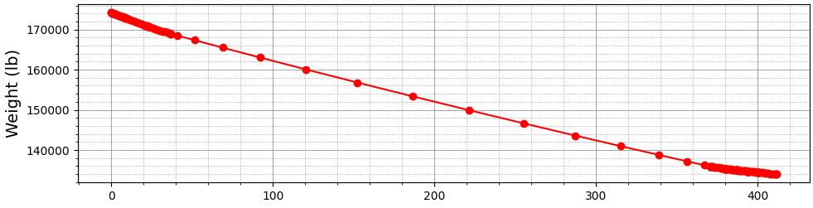
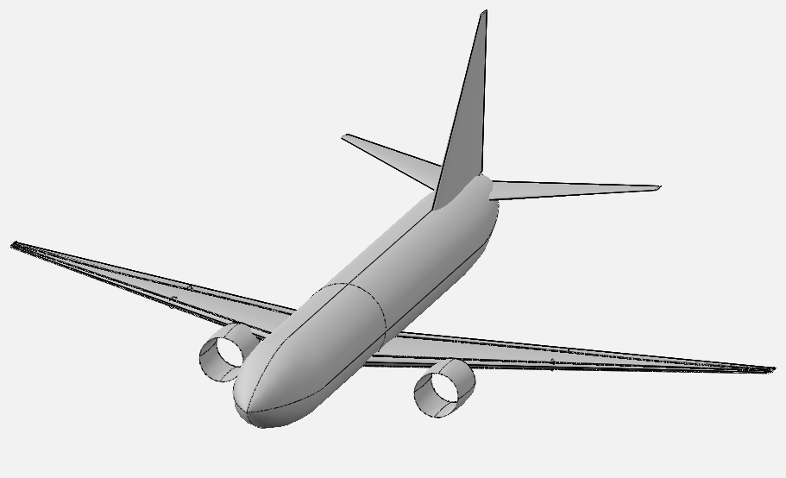
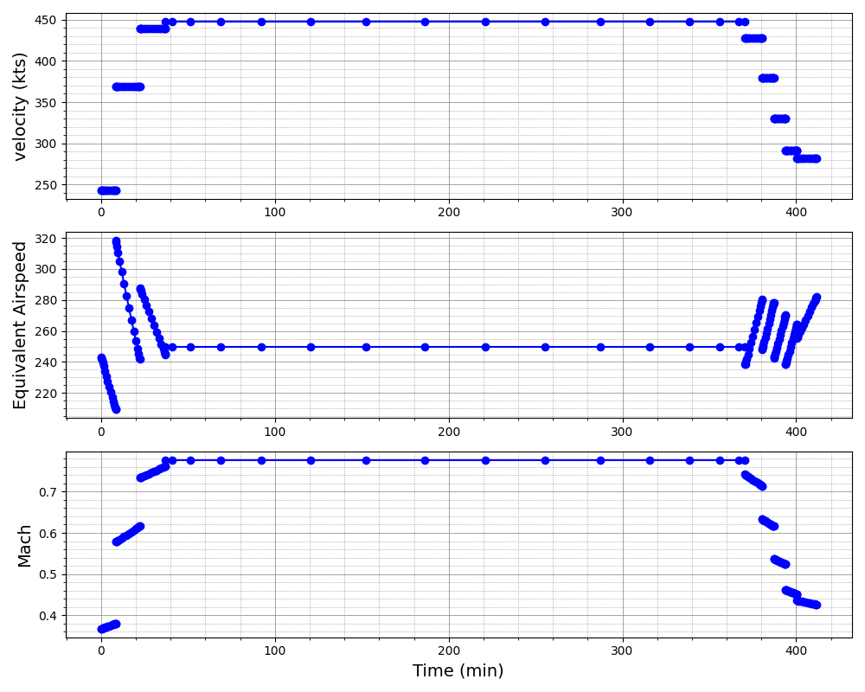
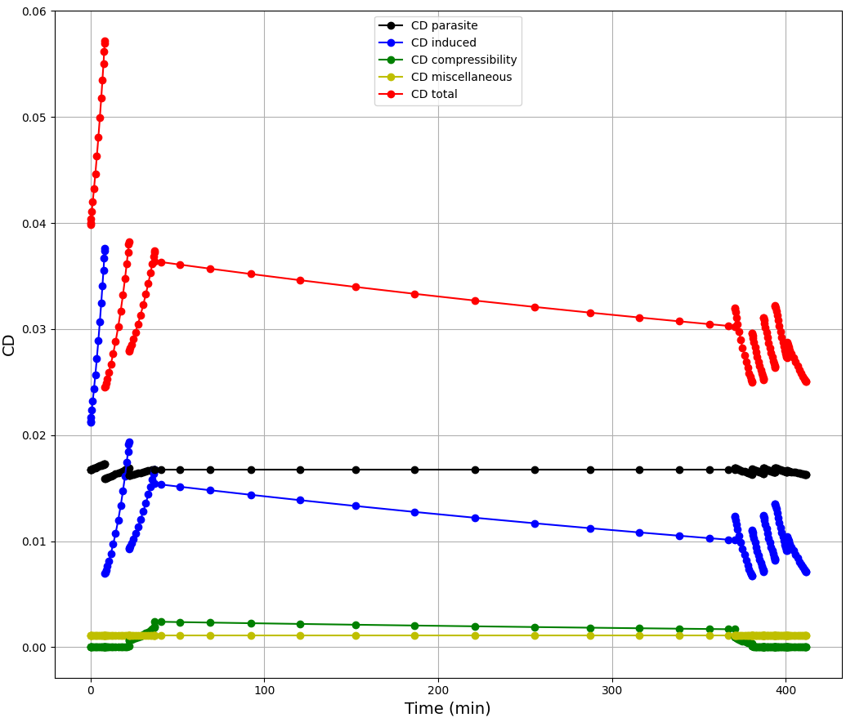
2、Prepare
Test if you setup SUAVE successfully
B737-800 in openvsp
Run the tut_mission_B737.py to see these pictures as shown above
Notes:
So next step we should test if we have setup SUAVE successfully. Please open the Tutorial folder, find the tut_mission_B737.py script, run it and just wait — I think it’ll take several seconds it’s very efficient. Then you’ll see lots of plots fill your whole screen! Like this, altitude, weight, lift, drag… all kinds of information will pop up right in front of you. This is just to check if you’ve installed SUAVE correctly. If you don’t see those plots, just let me know. Alright? Alright, we’ve got SUAVE installed.

Slide 6
3、Overall Design Process
What do we need to design for an aircraft?
Aerodynamic
Weight
Requirements
Mission
Configuration
Analysis
Thrust
Stability
…
Notes:
Before we start building our first SUAVE case, we first need to understand what conceptual aircraft design is, or more simply, what steps we need to go through. This is the overall conceptual design process; it’s not super formal, but it includes all the key steps. First, we need to figure out our aircraft requirements: you want to design a fighter jet, a helicopter or an airliner like Airbus, how many missiles the fighter will carries, if the helicopter is for rescue or security missions, and what range the airliner needs. These are all our basic requirements. Once we confirm the requirements, we define the flight mission, including takeoff, climb, cruise, descent, landing and other possible mission phases. After setting up the mission, we calculate initial aircraft parameters with standard formulas, such as maximum takeoff weight using the Breguet formula. Then we sketch out the aircraft layout. After that we do analyses like aerodynamics, weight updates and thrust analysis, and check if our aircraft can finish the flight mission. If not, we go back and adjust the design repeatedly until it meets the requirements. You’ve already learned those aircraft design knowledge from Professor Zhang or Professor Han, so I won’t talk too much about it, just a brief introduction, and now let’s focus on how to use SUAVE in this whole design process.

Slide 7
3、Overall Design Process - Build the main function
Main function: encapsulates aircraft, analysis, mission, and post-processing modules.
def main():
vehicle = vehicle_setup()
configs = configs_setup(vehicle)
configs_analyses = analyses_setup(configs)
analyses = SUAVE.Analyses.Analysis.Container()
analyses.configs = configs_analyses
simple_sizing(configs)
configs.finalize()
analyses.finalize()
mission = mission_setup(configs_analyses)
results = mission.evaluate() plot_mission(results)
return
🛠️ Config Setup
Create analysis config
✈️ Simple sizing
Complete basic settings of vehicle
🧮 Mission Calculate
Run the mission and plot the result
Notes:
Firstly we will build the main function. In the main function we call the component functions in sequence. And we will create those component functions later. In this stage we just create empty function and type the “pass” in these component functions, just to make sure this script can be executed normally later.

Slide 8
3、Overall Design Process - Define the Analyses
Base analysis: create analysis component and set aerodynamic solver.
def base_analysis(vehicle):
analyses = SUAVE.Analyses.Vehicle()
weights = SUAVE.Analyses.Weights.Weights_Transport()
weights.vehicle = vehicle
analyses.append(weights)
aerodynamics = SUAVE.Analyses.Aerodynamics.Fidelity_Zero()
aerodynamics.geometry = vehicle
analyses.append(aerodynamics)
energy = SUAVE.Analyses.Energy.Energy()
energy.network = vehicle.networks
analyses.append(energy)
planet = SUAVE.Analyses.Planets.Planet()
analyses.append(planet)
atmosphere = SUAVE.Analyses.Atmospheric.US_Standard_1976()
atmosphere.features.planet = planet.features
analyses.append(atmosphere)
return analyses
🔍Weights module
Calculate weight change by fuel
🔍Aerodynamic solver
This cases uses vortex
🛠️ Basic setting
No need to modify usually
Notes:
Once we have finished the main function, the basic framework for aircraft design, the first module will be developed is the base_analysis function. To start we need to define the output of this function, we want this function can return a analyses module so that we can use it to analysis the aerodynamic character of our aircraft in other steps. We create a class in the first line of this function. Then we add all the necessary components in turns. The weight module will update the total weight during the flight mission, the second part is most important, we choose the aerodynamic method in this part, in our simple case we just choose the Fidelity_Zero() module, because this module calculate quickly, is suitable for our class, we can get results in several seconds. Now we add the energy module, the planet module and the atmosphere module into this function so that it can run correctly. Usually we do not need to modify these sections, just keep the default settings.

Slide 9
3、Overall Design Process - Define the Analyses
Analyses_setup and configs_setup:
Set tag for analysis component,
if you have more than one analysis component you can call them by different tags.
def analyses_setup(configs):
analyses = SUAVE.Analyses.Analysis.Container()
for tag,config in configs.items():
analysis = base_analysis(config)
analyses[tag] = analysis
return analyses
def configs_setup(vehicle):
configs = SUAVE.Components.Configs.Config.Container()
base_config = SUAVE.Components.Configs.Config(vehicle)
base_config.tag = 'base'
configs.append(base_config)
return configs
🛠️ Basic setting
Transfer vehicle to analysis component
Notes:
Normally, we’ll add the base_analysis function into a analysis container. This way, we can throw in multiple analysis modules inside it for different needs. For instance, we often need special settings for control surfaces during the takeoff phase. In today’s simple case, we’re only using one single module—the base_analysis we just built. Still, just to keep our code clean and fully structured, we’ll make a container to hold it anyway. Correspondingly, we turn the vehicle settings into a config class. Then we pass this config to our analysis.

Slide 10
3、Overall Design Process - Define the mission
Mission_setup:
Define the flight mission, including takeoff, climb, cruise, descent, land
def mission_setup(analyses):
mission = SUAVE.Analyses.Mission.Sequential_Segments()
mission.tag = 'simple_mission'
airport = SUAVE.Attributes.Airports.Airport()
airport.altitude = 0.0 * Units.km
airport.delta_isa = 0.0
airport.atmosphere =
SUAVE.Attributes.Atmospheres.Earth.US_Standard_1976()
mission.airport = airport
🔍Airport setting
Sometime will need to modify, like takeoff from plateau
Notes:
Alright, great—our analysis framework is done. Now we’ll define the flight mission. Before the actual mission segments, we’ve got to input airport data first. Uh, you might think this is unnecessary — this part is mainly for special takeoff requirement, like high‑altitude departures. For example, Xizang in China is super high above sea level. If you want to analyze a mission taking off from an airport there, you’d set the airport altitude to… let me check—around 4.3 km for Changdu Bangda Airport, or about 3.6 km for Lhasa Gonggar Airport. Alright, back on track. For our simple case, we’ll just go with the generic airport settings. That means zero altitude, standard temperature, and standard atmosphere. Quick note here: delta_isa refers to the temperature difference between the actual temperature of airport and the standard temperature.

Slide 11
3、Overall Design Process - Define the mission
Define the takeoff
🛠️Basic segments class
Segments = SUAVE.Analyses.Mission.Segments
base_segment = Segments.Segment()
segment = Segments.Climb.Constant_Speed_Constant_Rate(base_segment)
segment.tag = "climb"
segment.analyses.extend( analyses.base )
segment.altitude_start = 0.0 * Units.km
segment.altitude_end = 10.668 * Units.km
segment.air_speed = 160.0 * Units['m/s']
segment.climb_rate = 6.0 * Units['m/s’]
mission.append_segment(segment)
Notes:
First, let’s define the takeoff segment. We set the altitude_start, altitude_end, climb air_speed, and climb_rate. Every flight segment we use is built based on a basic Segment class, we should create the base class in advance. Most of the parameters in our simple case come from the Boeing 737 test case, and a few are set based on my own experience, to make our case as simple as possible. You can adjust most of these values freely, as long as they stay reasonable and realistic. After we define a mission segment, please remember to add this segment into the mission.

Slide 12
3、Overall Design Process - Define the mission
Define the cruise
segment = Segments.Cruise.Constant_Speed_Constant_Altitude(base_segment)
segment.tag = "cruise"
segment.analyses.extend( analyses.base )
segment.air_speed = 230.412 * Units['m/s']
segment.distance = 2490. * Units.nautical_miles
mission.append_segment(segment)
Notes:
Then we move on to the cruise phase. 230 meters per second equals about Mach 0.8, a common setting for civil transport aircraft. But maybe in the near future, we’ll be flying on faster supersonic transport. Mach 1.3? Or 1.6, or Mach 2! Sorry let’s get back the point. The second parameter here is the cruise range. Attention, the units of range is not kilometer but nautical_miles we need to mark the units after the value with Units module. For me, the Units module is most impressive feature in SUAVE—like, in my own codes, I always use International System of units by default, and yeah, that’s convenient, saves time and keeps the code simple, but here’s the thing: once you start piling up tons of parameters, it’s super easy to lose track of what unit each one uses, because I can’t really be sure I’ve use International System units everywhere. But in the SUAVE, since the Units module, you can use any units you like, the only thing you need to do is just mark the units after value like this simple case. When the SUAVE execute it will transform all value into the same units system automatically. I think this is a really clever coding concept worth learning from. Alright back to our simple case, now we have define the cruise segment, don’t forget to add it in mission.

Slide 13
3、Overall Design Process - Define the mission
Define the descent
segment = Segments.Descent.Constant_Speed_Constant_Rate(base_segment)
segment.tag = "descent"
segment.analyses.extend( analyses.base )
segment.altitude_end = 0.0 * Units.km
segment.air_speed = 160.0 * Units['m/s']
segment.descent_rate = 6.0 * Units['m/s’]
mission.append_segment(segment)
return mission
Notes:
Next up is the descent segment. We just set the altitude_end, descent airspeed and descent_rate here, then add it to the mission. And don’t forget to return the mission class at the end. You might’ve noticed that, unlike the takeoff segment, we didn’t set altitude_start here. Because the SUAVE will automatically take the ending altitude of the last segment as the starting point for the next one, just to keep the flight mission consistent. So we just need to set the altitude_start in the first segment.

Slide 14
3、Overall Design Process - Create the Vehicle
Overall parameter
def vehicle_setup():
vehicle = SUAVE.Vehicle()
vehicle.tag = 'Boeing_737-800'
vehicle.mass_properties.max_takeoff = 79015.8 * Units.kg
vehicle.mass_properties.takeoff = 79015.8 * Units.kg
vehicle.mass_properties.operating_empty = 62746.4 * Units.kg
vehicle.mass_properties.max_zero_fuel = 62732.0 * Units.kg
vehicle.mass_properties.cargo = 10000. * Units.kg
vehicle.reference_area = 124.862 * Units['meters**2']
Notes:
Great, now we’re finally getting to the most important part — building our aircraft. First, we’ll lay out a few general parameters for the aircraft, then set up the geometry for every single component. Last week, Dr. Chen mentioned how the creator of OpenVSP first sketched an aircraft on a napkin. Today, we’re basically gonna draw our own aircraft, but with code instead. Like I said before, most of the parameters is from the Boeing 737 test case, in this part we define the max takeoff weight, and exact takeoff weight, operating empty weight, it means basic weight of this aircraft, no passenger, no cargo, no fuel, and max_zero_fuel weight, We all know that aircraft fuel is usually stored inside the wings. Without fuel, the wing structure is hollow. The maximum zero-fuel weight is defined to protect the structural loading of the wings. and the cargo weight. Reference area，we are familiar with this parameter, it’s important for calculating the lift coefficient and drag coefficient.

Slide 15
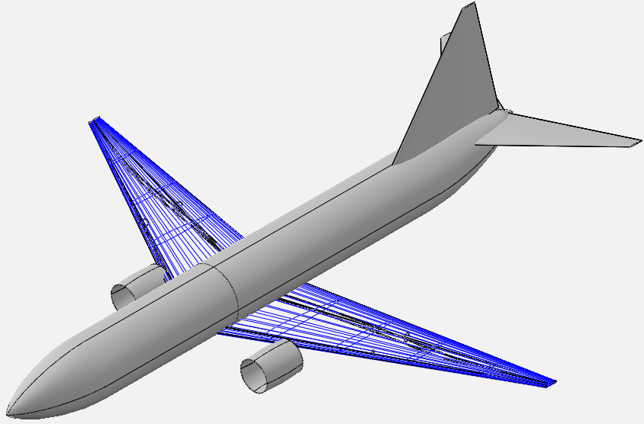
3、Overall Design Process - Create the Vehicle
Main Wing
wing = SUAVE.Components.Wings.Main_Wing()
wing.tag = 'main_wing'
wing.aspect_ratio = 10.18
wing.sweeps.quarter_chord = 25 * Units.deg
wing.thickness_to_chord = 0.1
wing.taper = 0.1
wing.spans.projected = 34.32 * Units.meter
wing.chords.root = 7.760 * Units.meter
wing.chords.tip = 0.782 * Units.meter
wing.chords.mean_aerodynamic = 4.235 * Units.meter
wing.areas.reference = 124.862 * Units['meters**2']
wing.twists.root = 4.0 * Units.degrees
wing.twists.tip = 0.0 * Units.degrees
wing.origin = [[13.61, 0, -1.27]] * Units.meter
wing.vertical = False
wing.symmetric = True
vehicle.append_component(wing)
Notes:
Then we define the main_wing, I have emphasis the main_wing in the picture. The main wing parameters defined in this part are quite intuitive, and I believe you all understand what each of these parameters means. And after define the main_wing just remember to add it in vehicle class.

Slide 16
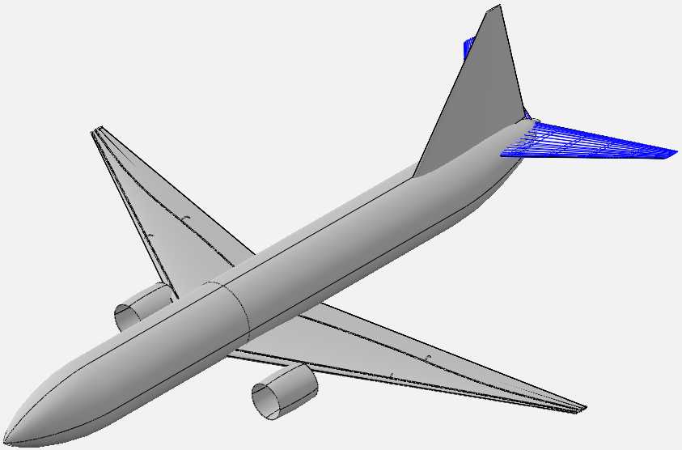
3、Overall Design Process - Create the Vehicle
Horizontal Tail
wing = SUAVE.Components.Wings.Horizontal_Tail()
wing.tag = 'horizontal_stabilizer'
wing.aspect_ratio = 6.16
wing.sweeps.quarter_chord = 40.0 * Units.deg
wing.thickness_to_chord = 0.08
wing.taper = 0.2
wing.spans.projected = 14.2 * Units.meter
wing.chords.root = 4.7 * Units.meter
wing.chords.tip = 0.955 * Units.meter
wing.chords.mean_aerodynamic = 3.0 * Units.meter
wing.areas.reference = 32.488 * Units['meters**2']
wing.twists.root = 3.0 * Units.degrees
wing.twists.tip = 3.0 * Units.degrees
wing.origin = [[32.83 * Units.meter,
0 , 1.14 * Units.meter]]
wing.vertical = False
wing.symmetric = True
vehicle.append_component(wing)
Notes:
Next up, the horizontal tail. It only generates a small amount of lift most of the time, and its real job is acting as a key control surface. Control the attack angle of aircraft. Even though we have created a separate component class, its parameter settings are exactly the same as the main wing, so I will not go into further detail here. You can try adjusting these parameters on your own if you like.

Slide 17
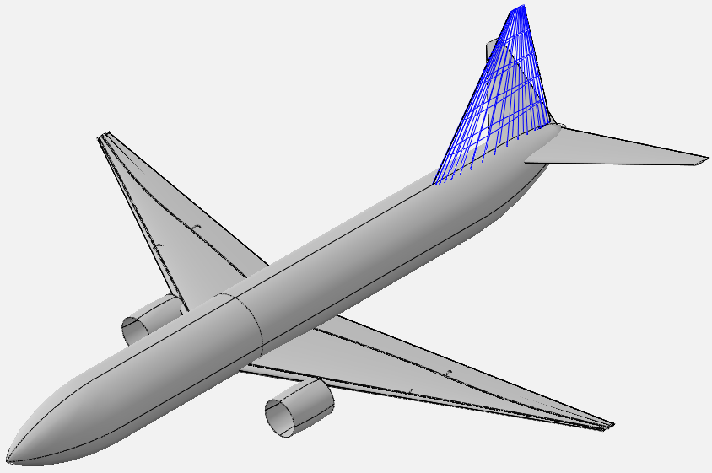
3、Overall Design Process - Create the Vehicle
Vertical Tail
wing = SUAVE.Components.Wings.Vertical_Tail()
wing.tag = 'vertical_stabilizer'
wing.aspect_ratio = 1.91
wing.sweeps.quarter_chord = 25. * Units.deg
wing.thickness_to_chord = 0.08
wing.taper = 0.25
wing.spans.projected = 7.777 * Units.meter
wing.chords.root = 8.19 * Units.meter
wing.chords.tip = 0.95 * Units.meter
wing.chords.mean_aerodynamic = 4.0 * Units.meter
wing.areas.reference = 27.316 * Units['meters**2']
wing.twists.root = 0.0 * Units.degrees
wing.twists.tip = 0.0 * Units.degrees
wing.origin = [[28.79, 0, 1.54]] * Units.meter
wing.vertical = True
wing.symmetric = False
vehicle.append_component(wing)
Notes:
Then the vertical tail. Just like the horizontal tail, it also works as a control surface, and it’s mainly in charge of the aircraft’s heading direction.

Slide 18
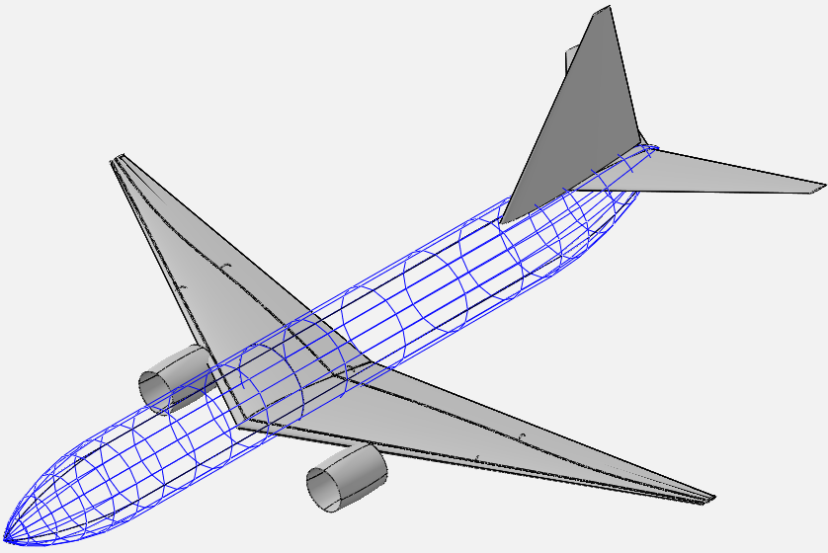
3、Overall Design Process - Create the Vehicle
Fuselage
fuselage = SUAVE.Components.Fuselages.Fuselage()
fuselage.tag = 'fuselage'
fuselage.fineness.nose = 1.6
fuselage.fineness.tail = 2.
fuselage.lengths.nose = 6.4 * Units.meter
fuselage.lengths.tail = 8.0 * Units.meter
fuselage.lengths.total = 38.02 * Units.meter
fuselage.width = 3.74 * Units.meter
fuselage.heights.maximum = 3.74 * Units.meter
fuselage.effective_diameter = 3.74 * Units.meter
fuselage.areas.side_projected = 142.1948 * Units['meters**2']
fuselage.areas.wetted = 446.718 * Units['meters**2']
fuselage.areas.front_projected = 12.57 * Units['meters**2’]
fuselage.heights.at_quarter_length = 3.74 * Units.meter
fuselage.heights.at_three_quarters_length = 3.65 * Units.meter
fuselage.heights.at_wing_root_quarter_chord = 3.74 * Units.meter
vehicle.append_component(fuselage)
Notes:
Now, moving on to the fuselage. Fineness of nose and tail, length of nose, length of tail, total length. And some area data for drag calculation. Among these data, the wetted area is the most critical, it essentially determines the value of friction drag. And then we define some extra dimensions, the height of quarter length, of three quarters length, and the height of wing root quarter chord. Unlike the wings, its design isn’t super straightforward. It narrows down in some sections and widens out in others, and it’s pretty hard to picture all those shape details just in our mind. That’s why we need extra methods to visualize the aircraft and check what it actually looks like. but we will save that for later, no hurry. Now, let’s keep moving and finish setting up the vehicle.

Slide 19
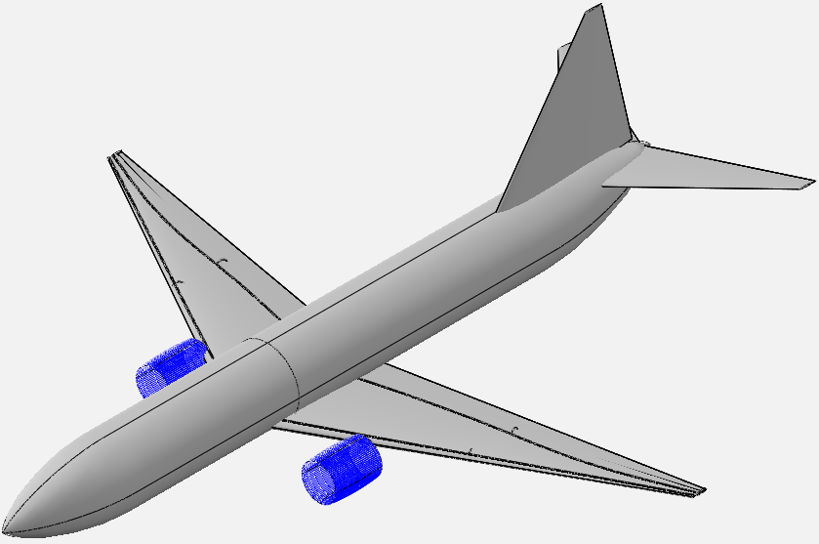
3、Overall Design Process - Create the Vehicle
Nacelle
nacelle = SUAVE.Components.Nacelles.Nacelle()
nacelle.tag = 'nacelle_1'
nacelle.length = 2.71
nacelle.inlet_diameter = 1.90
nacelle.diameter = 2.05
nacelle.areas.wetted = 1.1*np.pi*nacelle.diameter*nacelle.length
nacelle.origin = [[13.72, -4.86,-1.9]]
nacelle.flow_through = True
nacelle_airfoil = SUAVE.Components.Airfoils.Airfoil()
nacelle_airfoil.naca_4_series_airfoil = '2410'
nacelle.append_airfoil(nacelle_airfoil)
nacelle_2 = deepcopy(nacelle)
nacelle_2.tag = 'nacelle_2'
nacelle_2.origin = [[13.72, 4.86,-1.9]]
vehicle.append_component(nacelle)
vehicle.append_component(nacelle_2)
Notes:
Alright, the last geometry component we’ve got is the nacelle. The nacelle protects the engine, reduces drag, and provides several additional capabilities. We define the Length of nacelle, inlet diameter, and the max diameter of nacelle, it should be wider than the inlet. And then set the airfoil of nacelle to decrease the drag. Here we use the deepcopy function to create the other one nacelle, to make sure both nacelles share the same parameters, then we just place the second one symmetrically.

Slide 20
3、Overall Design Process - Create the Vehicle
Turbofan Network
turbofan = SUAVE.Components.Energy.Networks.Turbofan()
turbofan.tag = 'turbofan'
turbofan.number_of_engines = 2
turbofan.bypass_ratio = 5.4
turbofan.origin =
[[13.72, 4.86,-1.9],[13.72, -4.86,-1.9]] * Units.meter
turbofan.working_fluid = SUAVE.Attributes.Gases.Air()
Air ➡️ Ram ➡️ Inlet Nozzle ➡️ Fan ➡️ Low Pressure Compressor ➡️
High Pressure Compressor ➡️ Combustor ➡️ High Pressure Turbine ➡️
Low Pressure Turbine ➡️ Core Nozzle / Fan Nozzle ➡️ Thrust
Notes:
Alright, next up is the turbofan network. To be honest, I really wanted to simplify this whole part, since engine design isn’t my main research focus, and I don’t know much about it. But sadly, I totally failed at that. I don’t know how to simplify this part. In conceptual design sometimes we just need the Thrust and Fuel consumption. Maybe in other aircraft design research we just directly give the value of the two parameters. But SUAVE runs through a bunch of engineering formulas to calculate overall thrust and fuel consumption rate based on the engine cycle process. Anyway, since we can’t skip or simplify it, just copy the code as it is. I’ll try to explain those settings as possible as I can. And if anyone here knows more about engines, feel free to chime in and add extra info. So, well the first part we define the location of engineer, bypass ratio, number of engines, and work fluid is air of course. And the location and number of engines need to align with the nacelle settings.

Slide 21
3、Overall Design Process - Create the Vehicle
Turbofan Network
ram = SUAVE.Components.Energy.Converters.Ram()
ram.tag = 'ram'
turbofan.append(ram)
inlet_nozzle =
SUAVE.Components.Energy.Converters.Compression_Nozzle()
inlet_nozzle.tag = 'inlet_nozzle'
inlet_nozzle.polytropic_efficiency = 0.98
inlet_nozzle.pressure_ratio = 0.98
turbofan.append(inlet_nozzle)
Air ➡️ Ram ➡️ Inlet Nozzle ➡️ Fan ➡️ Low Pressure Compressor ➡️
High Pressure Compressor ➡️ Combustor ➡️ High Pressure Turbine ➡️
Low Pressure Turbine ➡️ Core Nozzle / Fan Nozzle ➡️ Thrust
Notes:
Alright, moving on to the ram and inlet nozzle. The ram doesn’t have any extra parameters, and we just set the inlet polytropic efficiency and pressure ratio to 0.98. Basically, that means we use a pretty high-efficiency engine here.

Slide 22
3、Overall Design Process - Create the Vehicle
Turbofan Network
fan = SUAVE.Components.Energy.Converters.Fan()
fan.tag = 'fan'
fan.polytropic_efficiency = 0.93
fan.pressure_ratio = 1.7
turbofan.append(fan)
compressor =
SUAVE.Components.Energy.Converters.Compressor()
compressor.tag = 'low_pressure_compressor'
compressor.polytropic_efficiency = 0.91
compressor.pressure_ratio = 1.14
turbofan.append(compressor)
Air ➡️ Ram ➡️ Inlet Nozzle ➡️ Fan ➡️ Low Pressure Compressor ➡️
High Pressure Compressor ➡️ Combustor ➡️ High Pressure Turbine ➡️
Low Pressure Turbine ➡️ Core Nozzle / Fan Nozzle ➡️ Thrust
Notes:
Next is the fan and low pressure compressor, create component, set parameters, add it into turbofan network.

Slide 23
3、Overall Design Process - Create the Vehicle
Turbofan Network
compressor =
SUAVE.Components.Energy.Converters.Compressor()
compressor.tag = 'high_pressure_compressor'
compressor.polytropic_efficiency = 0.91
compressor.pressure_ratio = 13.415
turbofan.append(compressor)
Air ➡️ Ram ➡️ Inlet Nozzle ➡️ Fan ➡️ Low Pressure Compressor ➡️
High Pressure Compressor ➡️ Combustor ➡️ High Pressure Turbine ➡️
Low Pressure Turbine ➡️ Core Nozzle / Fan Nozzle ➡️ Thrust
Notes:
Then high pressure compressor, the setting are very similar.

Slide 24
3、Overall Design Process - Create the Vehicle
Turbofan Network
combustor =
SUAVE.Components.Energy.Converters.Combustor()
combustor.tag = 'combustor'
combustor.efficiency = 0.99
combustor.alphac = 1.0
combustor.turbine_inlet_temperature = 1450 # K
combustor.pressure_ratio = 0.95
combustor.fuel_data =
SUAVE.Attributes.Propellants.Jet_A()
turbofan.append(combustor)
Air ➡️ Ram ➡️ Inlet Nozzle ➡️ Fan ➡️ Low Pressure Compressor ➡️
High Pressure Compressor ➡️ Combustor ➡️ High Pressure Turbine ➡️
Low Pressure Turbine ➡️ Core Nozzle / Fan Nozzle ➡️ Thrust
Notes:
Then combustor. Ok here we can talk about several key parameters. First, **alpha c** stands for the combustion ratio. Normally, alpha c equals 1.0 means the air and fuel mixture is balanced. If there is more air and less fuel, this value will be greater than 1, combustion will be more complete and the engine will have higher efficiency. If there is less air and more fuel, the value will be lower than 1, that will increase engine power, but incomplete combustion may cause black smoke or even flameout. Next is the fuel setting. **Jet_A** refers to conventional aviation fuel we usually use it. If you are working on some aircraft which use other fuel, for example hydrogen-powered aircraft, simply replace Jet_A with liquid hydrogen. The corresponding fuel properties are already given in SUAVE source code.

Slide 25
3、Overall Design Process - Create the Vehicle
Turbofan Network
turbine = SUAVE.Components.Energy.Converters.Turbine()
turbine.tag='high_pressure_turbine'
turbine.mechanical_efficiency = 0.99
turbine.polytropic_efficiency = 0.93
turbofan.append(turbine)
turbine = SUAVE.Components.Energy.Converters.Turbine()
turbine.tag='low_pressure_turbine'
turbine.mechanical_efficiency = 0.99
turbine.polytropic_efficiency = 0.93
turbofan.append(turbine)
Air ➡️ Ram ➡️ Inlet Nozzle ➡️ Fan ➡️ Low Pressure Compressor ➡️
High Pressure Compressor ➡️ Combustor ➡️ High Pressure Turbine ➡️
Low Pressure Turbine ➡️ Core Nozzle / Fan Nozzle ➡️ Thrust
Notes:
Alright let’s continue, high pressure turbine and low pressure turbine, also similar setting.

Slide 26
3、Overall Design Process - Create the Vehicle
Turbofan Network
nozzle =
SUAVE.Components.Energy.Converters.Expansion_Nozzle()
nozzle.tag = 'core_nozzle'
nozzle.polytropic_efficiency = 0.95
nozzle.pressure_ratio = 0.99
turbofan.append(nozzle)
===========================================================
nozzle =
SUAVE.Components.Energy.Converters.Expansion_Nozzle()
nozzle.tag = 'fan_nozzle'
nozzle.polytropic_efficiency = 0.95
nozzle.pressure_ratio = 0.99
turbofan.append(nozzle)
Air ➡️ Ram ➡️ Inlet Nozzle ➡️ Fan ➡️ Low Pressure Compressor ➡️
High Pressure Compressor ➡️ Combustor ➡️ High Pressure Turbine ➡️
Low Pressure Turbine ➡️ Core Nozzle / Fan Nozzle ➡️ Thrust
Notes:
Then we move on to the core nozzle and fan nozzle. These two components work in parallel within the engine cycle. A turbofan engine has a core flow and a bypass flow, just like this. The bypass ratio refers to the mass flow ratio between these two streams.

Slide 27
3、Overall Design Process - Create the Vehicle
Turbofan Network
thrust = SUAVE.Components.Energy.Processes.Thrust()
thrust.tag ='compute_thrust'
thrust.total_design = 2*24000. * Units.N
turbofan.thrust = thrust
altitude = 35000.0*Units.ft
mach_number = 0.78
turbofan_sizing(turbofan,mach_number,altitude)
vehicle.append_component(turbofan)
return vehicle
Air ➡️ Ram ➡️ Inlet Nozzle ➡️ Fan ➡️ Low Pressure Compressor ➡️
High Pressure Compressor ➡️ Combustor ➡️ High Pressure Turbine ➡️
Low Pressure Turbine ➡️ Core Nozzle / Fan Nozzle ➡️ Thrust
Notes:
Lastly, let’s talk about thrust. Here we set the engine’s design operating condition. However, in actual calculations, the engine won’t always run under design condition. The code will automatically compute the engine off-design performance, using the design conditions as its basis. Also, remember to add the turbofan network to your vehicle class.

Slide 28
3、Overall Design Process - Create the Vehicle
Simple sizing
def simple_sizing(configs):
base = configs.base
base.pull_base()
base.mass_properties.max_zero_fuel =
0.9 * base.mass_properties.max_takeoff
for wing in base.wings:
wing.areas.wetted = 2.0 * wing.areas.reference
wing.areas.exposed = 0.8 * wing.areas.wetted
wing.areas.affected = 0.6 * wing.areas.wetted
base.store_diff()
return
Simple sizing: This function automatically computes unspecified critical parameters for the vehicle using overall design inputs, finalizing the aircraft model for subsequent analysis.
Notes:
Alright, we’ve finally gotten through the turbofan network. We’ve now finished building all the core parts of the aircraft. We still have a few small things to do. We’ll use the simple_sizing function to add those aircraft parameters which are secondary but also critical for calculation. Of course, you can put all these settings directly inside the vehicle function. The simple_sizing function isn’t necessary, but it demonstrates modular thinking. We take these standard, well-established rules out separately, once define them, we will never change it. This way, we can stay focused on those most important parameters for our aircraft design.

Slide 29
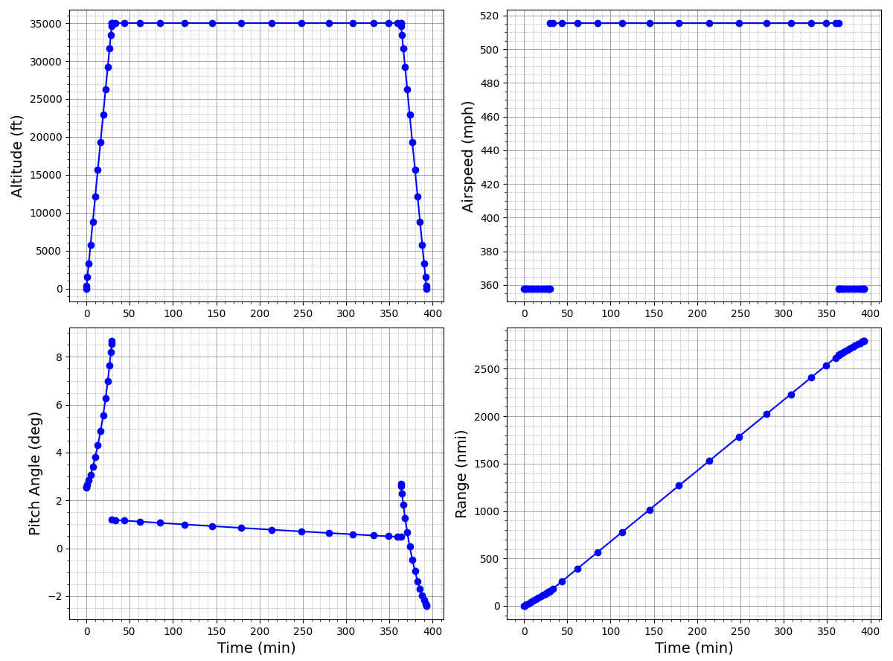
3、Overall Design Process - Plot the result
plot_mission:
Plot mission result by matplotlib
def plot_mission(results,line_style='bo-'):
plot_flight_conditions(results, line_style)
plot_aerodynamic_forces(results, line_style)
plot_aerodynamic_coefficients(results, line_style)
plot_drag_components(results, line_style)
plot_altitude_sfc_weight(results, line_style)
plot_aircraft_velocities(results, line_style)
return
Notes:
Last up is plotting the results. SUAVE has some built-in plotting functions, and I completely copied this part from the Boeing 737 test case. You can also create your own plotting functions to make plot you need. And that’s it — we’ve finished writing our entire simple case! Now just run it!

Slide 30
4、Main Modules - Vehicle
1、Download openvsp==3.29.1
cmd
cd D:\OpenVSP-3.29.1-win64\python ##change the path
pip install -r requirements.txt
add
from SUAVE.Input_Output.OpenVSP import write
to the import section
add
write(vehicle, 'base')
after vehicle_setup() in main()
Run your code again, “base.vsp3”will be generated under your code directory
Notes:
Congratulations! By now, we’ve basically figure out how SUAVE works, and we’ve built a simple case of our very own. Do anyone remember earlier when we were setting up the fuselage? I mentioned those geometry parameters in the code are pretty hard to picture in our mind. Now, we’re gonna import the OpenVSP interface, so we can actually take a look at our aircraft. There is a python folder under openvsp path, open the cmd terminal under the folder, and remember to activate your python environment for SUAVE in the cmd, then type pip install like I write in powerpoint. And then back to our code, import the openvsp at the first of code, and add write(vehicle, ‘base’) in main function, now run the code again, a vsp file will be generated under your code directory. You can open the vsp file in openvsp to check whether our model is correct and reasonable, we can get a clear 3D view of our aircraft.

Slide 31
4、Main Modules - Vehicle
How SUAVE create the aircraft geometry
# Create the wing
wing_id = vsp.AddGeom( "WING" )
vsp.SetGeomName(wing_id, wing.tag)
area_tags[wing.tag] = ['wings',wing.tag]
x_secs = []
x_sec_curves = []
for i_segs in range(0,n_segments+2):
x_secs.append('XSec_' + str(i_segs))
x_sec_curves.append('XSecCurve_' + str(i_segs))
vsp.SetParmVal( wing_id,'X_Rel_Location','XForm',wing_x)
vsp.SetParmVal( wing_id,'Y_Rel_Location','XForm',wing_y)
vsp.SetParmVal( wing_id,'Z_Rel_Location','XForm',wing_z)
Partial source code of vsp_write
Notes:
How our code turns into a real aircraft model? On the slide, you can see part of the SUAVE source code. This section is for creating a wing component. It converts the parameters we set in our code into OpenVSP variables. Right here, it’s translating the XYZ coordinates, which means the location of each component.

Slide 32
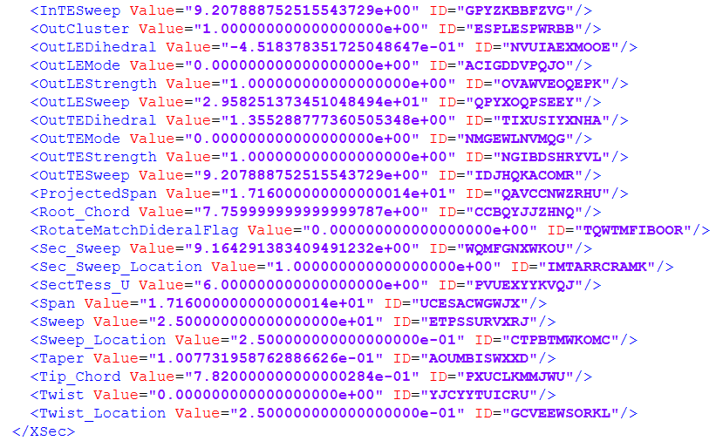
4、Main Modules - Vehicle
How OpenVSP create the aircraft geometry
OpenVSP uses XML format to record geometric parameters of each component with structured tags.
wing.sweeps.quarter_chord=25
wing.thickness_to_chord =0.1
wing.taper =0.1
wing.spans.projected =34.32
wing.chords.root =7.760
wing.chords.tip =0.782
Partial text of vsp file
Notes:
If you’re curious, you can open the VSP file with any text editor. You’ll see it’s structured in XML format like this. It stores every single aircraft parameter. You can easily find the values we defined in our code, but most of the content are auto-filled settings. As you might know, building a full geometry model requires way more data than basic overall analysis, and OpenVSP will automatically fill in those extra details for us.

Slide 33
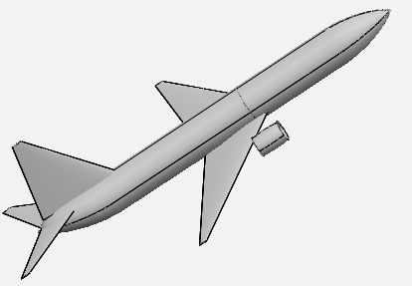
4、Main Modules - Mission
If you want your flight mission to be more realistic, you should adopt a multi-segment climb and descent mode to achieve smoother speed transitions and configure distinct aircraft states for takeoff and landing.
Flight Mission
Takeoff & Climb
Cruise
Descent & landing
Notes:
To keep our simple case as simple as possible, I only set up three mission segments: takeoff, cruise and descent. A more realistic flight mission should include more segments, takeoff, climb, climbing at different speeds, cruise, descent, descent at different speed, and final landing. The aircraft operates differently in each stage. For takeoff, we will change the flaps angle to generate extra lift, and the landing gear is retracted afterward. During landing, speed brakes are deployed and the landing gear is lowered. Real mission analysis is extremely complex, In this part I won’t go into further details, just give you a quick reminder.

Slide 34
4、Main Modules – Aerodynamic Analysis
Main aerodynamic analysis modules in the SUAVE
Fidelity_Zero | Based on VLM method, it is suitable for aerodynamic force calculation of low-speed aircraft.
Supersonic_Zero | Also based on VLM method, but modified with empirical formulas for supersonic conditions.
AERODAS | An airfoil aerodynamic prediction method developed by NASA. Its core function is to calculate the CL and CD of airfoils over the entire angle of attack range through empirical formulas and curve fitting.
SU2_Euler | Generate volume meshes via Gmsh, run CFD simulations in SU2.
Notes:
In our simple case, we’re using the most basic Fidelity_Zero module. This aerodynamic module is based on the vortex lattice method and is suitable for subsonic aircraft. If we need to analyze supersonic aircraft, we can use the Supersonic_Zero module, which is also based on the vortex lattice method. However, the basic vortex lattice method is not applicable to supersonic conditions, so this module uses some engineering formulas to correct the aerodynamic results for supersonic cases, and you can take a look at its source code if you’re interested. The AERODAS module is an engineering method developed by NASA for predicting lift and drag, and it’s also built into the code. In addition, SUAVE demonstrates how to use external solvers for aerodynamic analysis. In the SU2_Euler module, SUAVE first calls the OpenVSP interface to generate the aircraft surface mesh, then uses Gmsh to create the volume mesh, and finally generates the SU2 config file and runs SU2 to perform the aerodynamic analysis.

Slide 35
5、Customization & Extension
How to optimize your aircraft via SUAVE
from simple_case import *
def change_sweep(vehicle, var):
vehicle.wings.main_wing.sweeps.quarter_chord = (25 + var) * Units.deg
return vehicle
def opt_fun(vehicle, var):
vehicle = change_sweep(vehicle, var)
configs = configs_setup(vehicle)
configs_analyses = analyses_setup(configs)
analyses = SUAVE.Analyses.Analysis.Container()
analyses.configs = configs_analyses
configs.finalize()
analyses.finalize()
Change sweep of main_wing
Build analysis component with new vehicle
Notes:
Basically, that’s all for the main content of today’s class, and next we’ll cover some extra topics; the first example is building a simple optimization case, the key step in optimization is to convert our entire analysis process into an objective function that can be used by optimization algorithms, we won’t run the actual optimization today, we’ll just try to build a very basic objective function, first let’s see how to modify the aircraft using design variables, there’s only one line of code here: we take the vehicle, update the parameters, and return the new vehicle, next is how to extract the objective value, we use the updated aircraft to re-create and initialize all the analysis components,

Slide 36
5、Customization & Extension
How to optimize your aircraft via SUAVE
mission = mission_setup(configs_analyses)
results = mission.evaluate()
max_mass = configs.base.mass_properties.max_takeoff
last_segment = results.segments.values()[-1]
final_mass = last_segment.conditions.weights.total_mass[-1, 0]
fuel_mass = max_mass - final_mass
return fuel_mass
Analysis mission with new vehicle and extract the objective value we need
Notes:
Then run the mission analysis again, finally we get the corresponding value from the mission results, in my setup, the objective is fuel consumption, so we take the initial weight and the final weight, and the difference between them is the fuel consumption.

Slide 37
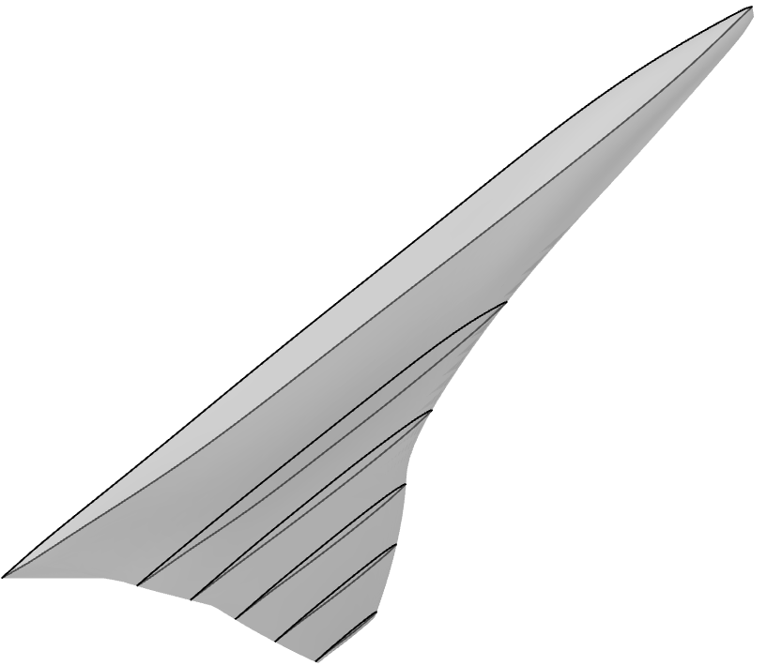
def cst_rec(para, N1=0.5, N2=1, n_points=60, psi_end=1.0):
##从参数列表提取参数赋值变量
order = int((len(para) - 8)/2)
coeffs = np.array([para[1:order+2],para[order+2:(order+1)*2+1]])
dy_upper = para[-2]; dy_lower = para[-1]
psi = np.linspace(0, psi_end, n_points)
coeffs_upper = coeffs[0]
coeffs_lower = coeffs[1]
# 生成Bernstein基函数
B = np.zeros((n_points, order+1))
for i in range(order+1):
B[:, i] = comb(order, i) * (psi**i) * (1 - psi)**(order-i)
# 计算上下表面坐标
y_upper = (psi**N1 * (1 - psi)**N2) * (B @ coeffs_upper) + psi*dy_upper
y_lower = (psi**N1 * (1 - psi)**N2) * (B @ coeffs_lower) + psi*dy_lower
coord_u = np.array([psi, y_upper])
coord_l = np.array([psi, y_lower])
return coord_u, coord_l
def wing_from_para(para_csv: str = "6.64_simple.csv"):
para = pd.read_csv(para_csv).to_numpy()
wing = SUAVE.Components.Wings.Main_Wing()
wing.tag = 'main_wing'
n_sec = para.shape[0]; cst_order = int((para.shape[1] - 6)/2 - 1) ##6个位置尺寸参数，其余为cst
chord_root = (para[0, -4] - para[0, -5]) * Units.meters; chord_tip = (para[-1, -4] - para[-1, -5]) * Units.meters
span = 2*(para[-1, 0] - para[0, 0]) * Units.meters
wing.total_length = chord_root
wing.spans.projected = span
wing.chords.root = chord_root
wing.chords.tip = chord_tip
wing.areas.reference = 300.6 * Units.meters**2
# wing.sweeps.quarter_chord = 33. * Units.degrees
# wing.twists.root = 0.0 * Units.degrees
# wing.twists.tip = 0.0 * Units.degrees
# wing.dihedral = 0 * Units.degrees
wing.origin = [[0.,0.,0]]
wing.aerodynamic_center = [0,0,0]
wing.vertical = False
wing.symmetric = True
wing.high_lift = True
wing.dynamic_pressure_ratio = 1.0
dih_list = []
area = 0
for i in range(n_sec-1):
segment = SUAVE.Components.Wings.Segment()
segment.tag = 'section_'+str(i+1)
segment.percent_span_location = (para[i,0]/para[-1,0])
segment.twist = 0. * Units.deg ##无扭转角
root = para[i, -4] - para[i, -5]
tip = para[i+1, -4] - para[i+1, -5]
segment.root_chord_percent = root/wing.chords.root
dih_ag = float(math.atan((para[i+1,-3]-para[i,-3])/(para[i+1,0]-para[i,0]))*180/math.pi)
dih_list.append(dih_ag)
segment.dihedral_outboard = dih_ag * Units.deg
# print(para[i,0], para[-1,0], dih_ag, segment.percent_span_location)
x00, x01, x10, x11 = para[i, -5], para[i, -4], para[i+1, -5], para[i+1, -4]
x0 = x00 + 0.25 * (x01 - x00); x1 = x10 + 0.25 * (x11 - x10)
y0, y1, z0, z1 = para[i, 0], para[i+1, 0], para[i, -3], para[i+1, -3]
segment.sweeps.quarter_chord = (90 - math.atan(math.sqrt((y1 - y0)**2 + (z1 - z0)**2)
/(x1 - x0))*180/math.pi) * Units.degrees
print(segment.sweeps.quarter_chord/Units.degrees)
area += 0.5 * (root+tip) * (y1-y0)
segment.airfoil_type = "file"
airfoil_data1 = Data()
airfoil_data1.tag = 'airfoil' # 这个 tag 很重要，它作为 key 用于后续访问
filename = f"airfoil\\{i+1}.dat"
coord_u, coord_l = cst_rec(para[i], n_points=100)
thick = (coord_u[1, :] - coord_l[1, :]).max()
segment.thickness_to_chord = thick ##计算厚度弦长比
if i == 0:
wing.thickness_to_chord = thick
coords = np.concatenate([coord_l.T[::-1], coord_u.T], axis=0)
np.savetxt(filename, coords, '%.5f')
airfoil_data1.coordinate_file = filename # 重要的坐标文件路径
segment.append_airfoil(airfoil_data1) # 添加 airfoil 数据到 segment
wing.Segments.append(segment)
wing.aspect_ratio = (0.5*span)**2/area
# wing.aspect_ratio *= 4.5
print(wing.aspect_ratio)
segment = SUAVE.Components.Wings.Segment()
segment.tag = 'tip'
segment.percent_span_location = 1
segment.twist = 0. * Units.deg
segment.root_chord_percent = (para[-1, -4] - para[-1, -5])/(para[0, -4] - para[0, -5])
segment.dihedral_outboard = 20 * Units.degrees
# segment.sweeps.quarter_chord = sweep_list[12] * Units.degrees
segment.thickness_to_chord = 0.04
wing.Segments.append(segment)
# Fill out more segment properties automatically
wing = segment_properties(wing)
return wing
5、Customization & Extension
Generate custom wings based on segmented CST parameters
Generate airfoil file
CST_Para csv file
Set para to wing component
Calculate dihedral and sweep of each section
y=0
y=1
Notes:
In your future use, you can fully explore your creativity to further develop and customize the program. I will demonstrate a small tool I recently developed. It creates a vehicle object using segmented CST parameter lists. First, it generates standard normalized airfoil files based on the given CST parameters. Next, it calculates the dihedral and sweep angles of the segmented wing sections. Finally, it assigns all computed parameters to the corresponding vehicle attributes.
Let me briefly conclude today’s lecture. To be honest, SUAVE still has many imperfections. Its interpolation algorithms are relatively outdated, and the nested module structure is overly complicated. However, aircraft design works in a similar way. When you improve the lift-to-drag ratio, takeoff and landing performance may degradation. When you try to mitigate sonic boom, drag tends to increase instead.
In optimization theory, there is a core concept called Pareto optimality. It means that when you can no longer enhance one performance indicator without weakening others, the system reaches a Pareto optimal state. To me, it embodies the philosophy of balance.
The developers of SUAVE tried to strike a balance between usability and extensibility. In aircraft design, we balance cruise performance and takeoff-and-landing preformance. In daily life, we balance academic work and personal life. We have to realize that a perfect, all-round optimal solution rarely exists. What we can do is to seek the balance point.
Therefore, I wish all of you can find your own Pareto optimum in life.

Slide 38
Thank You！
Student Lecturer: Lin Yi
Date：April 29, 2026
Email：linyi@mail.nwpu.edu.cn
Notes:
Thank you for coming to my class today. The holiday starts this Friday, so I wish you all a happy Labor Day!

